Slide 1



Data Track 3 - Advanced Data Analysis
Connect Session #2
Week Starting: 11/03/2022

Slide 2
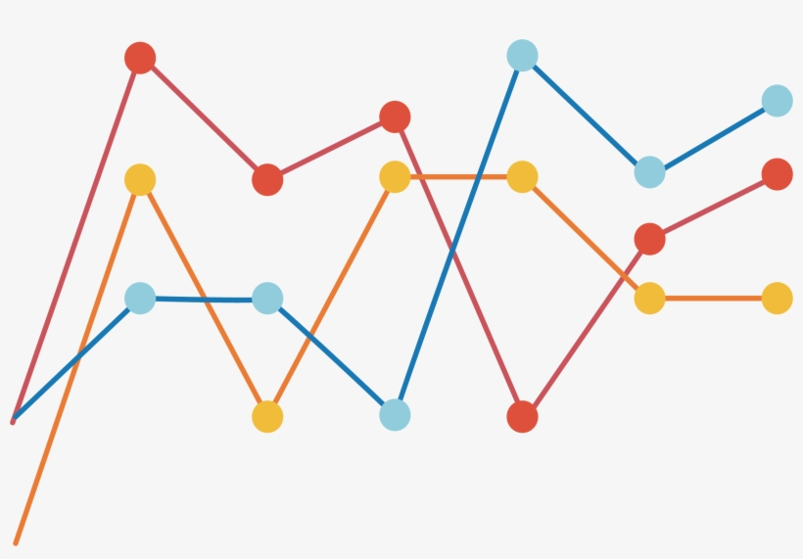
Project 1: Query a Digital Music Store Discussion & Walkthrough
Notes:
….

Slide 3
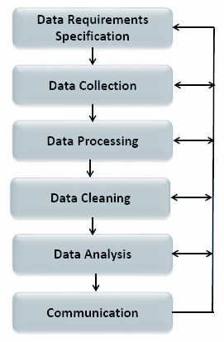
Data Analysis Process

Slide 4
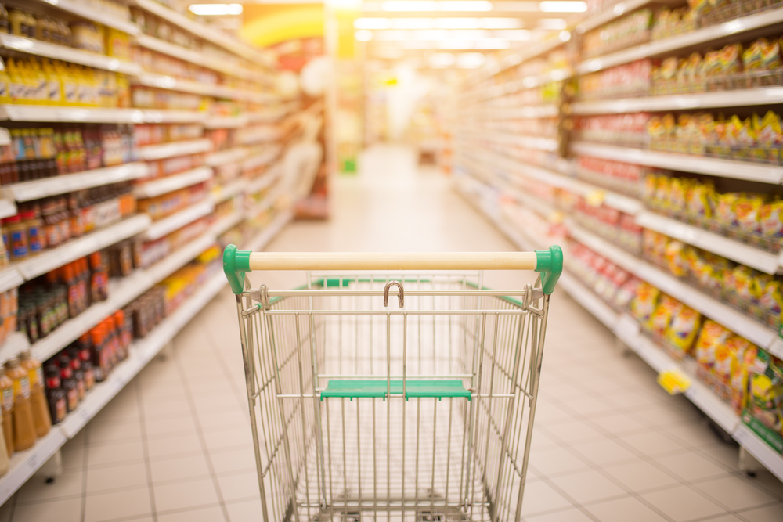
Group activity: San Francisco Restaurant Health Inspections
Notes:
….

Slide 5
Dataset Description
The San Francisco Dept. of Public Health’s database of businesses, inspections of those businesses, and violations found during the inspections. Per the latter, we have 3 tables for each entity:
Businesses
Inspections
Violations
We need to apply the data analysis process to our dataset and extract intriguing insights.
https://data.sfgov.org/Health-and-Social-Services/Restaurant-Scores-LIVES-Standard/pyih-qa8i

Slide 6

Closing Reminders
Check Schedule for deadlines
Read the student handbook
Attend the weekly session every week at the same time(unless specified otherwise on slack and e-mail)

Slide 7

© 2020, Udacity. All rights reserved.

